Slide 1
🍻 Hold my NeRF!
Niklas Bieck, Fabiano Manschein, Yuya Takagi

Slide 2
Agenda
Introduction
Problem
Goal
Our solution
Proposed pipeline
Dataset constraints
Preprocessing
Camera pose estimation
NeRF
Mesh Creation
Progress so far
Supported
Handheld

Slide 3
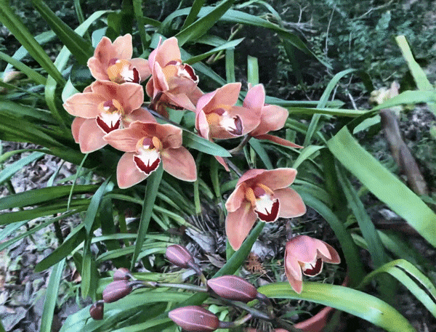
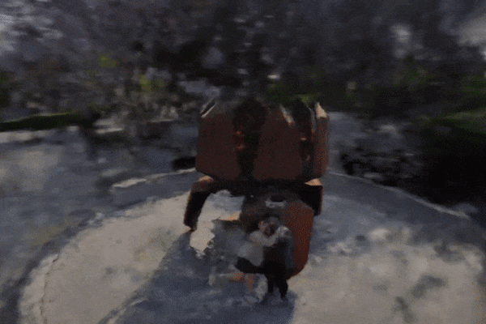
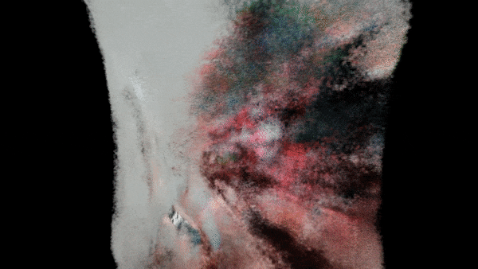
Introduction
matthewtancik.com/nerf
360° capture in Ghent
Failed Rubik's Cube capture

Slide 4

















Problem
Neural Radiance Fields (NeRF) typically require multiple camera poses for a good 3d representation of the scene.
Problems arise when the camera is still and the object is moving.

Slide 5
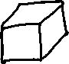








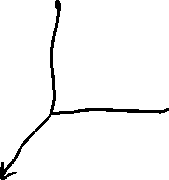

Goal
Our goal is to allow NeRFs to be generated from a RGB video of a hand-held object, which can then be converted to a 3d mesh.

Slide 6
Our solution
We will deceive our camera pose estimator by creating the illusion of camera movement around an object, while the actual movement is performed by the object itself.
We also need to remove the hand to avoid it showing up in the 3d representation.
But how?

Slide 7
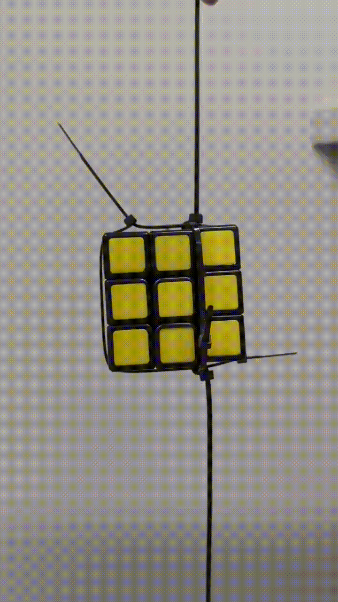
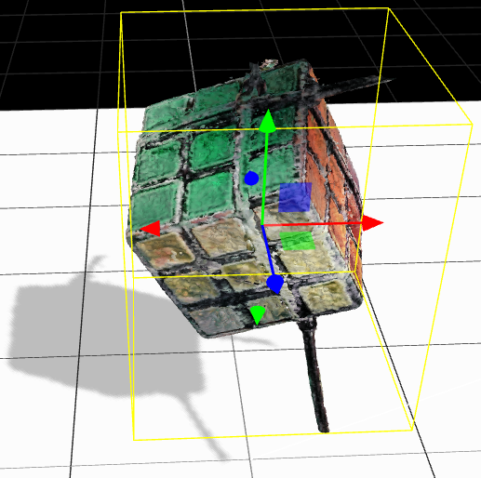




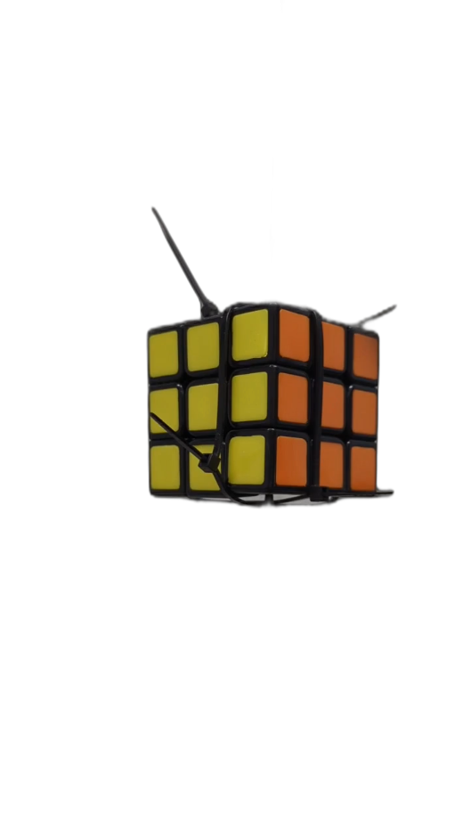
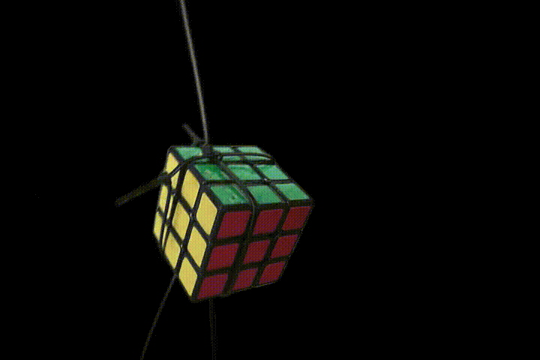
Proposed pipeline
Generated mesh
(Marching Cubes)
RGB Video
Estimate camera poses (COLMAP)
Object-only images
Transforms
Object-only images
3D Representation (NeRF)
Preprocessing
NeRF
Notes:
Take a photo or video of an object
Bg seg
NERF
output

Slide 8
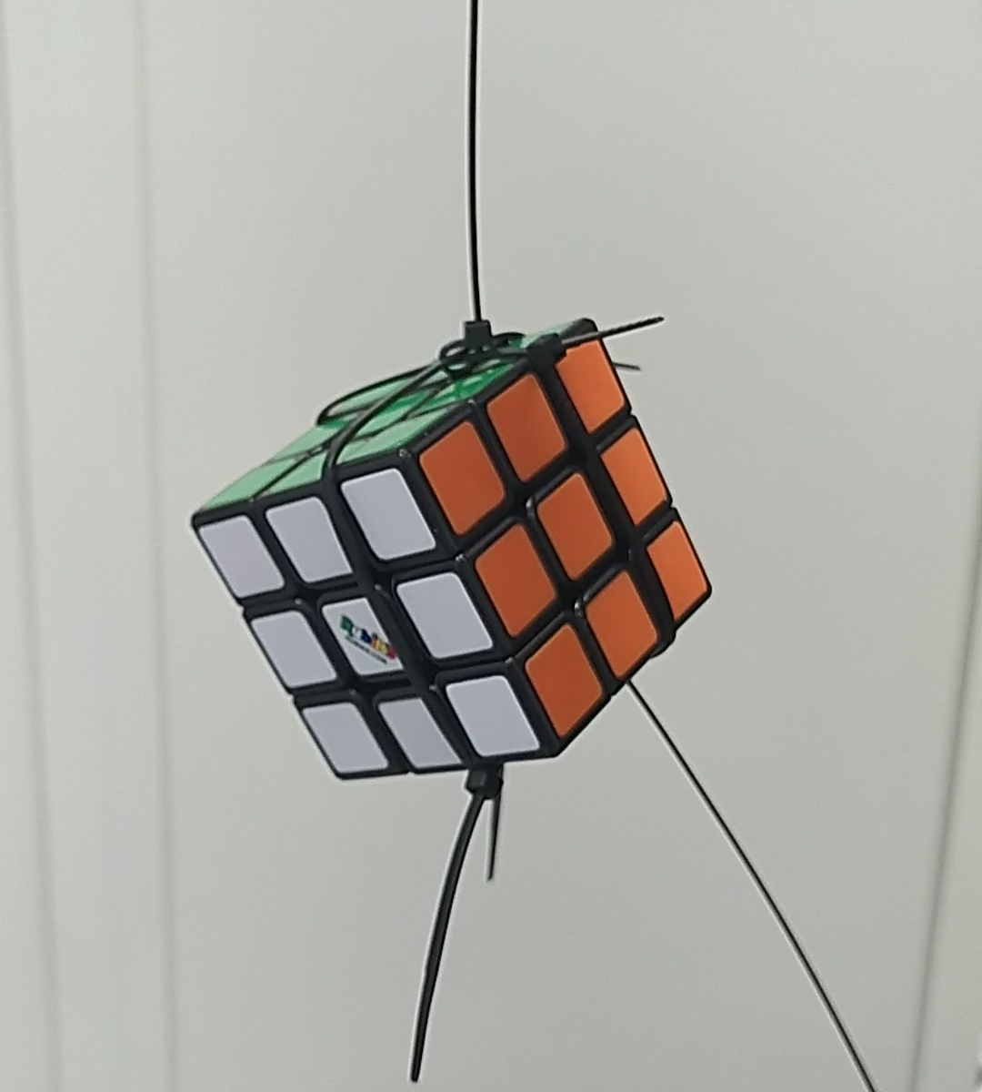
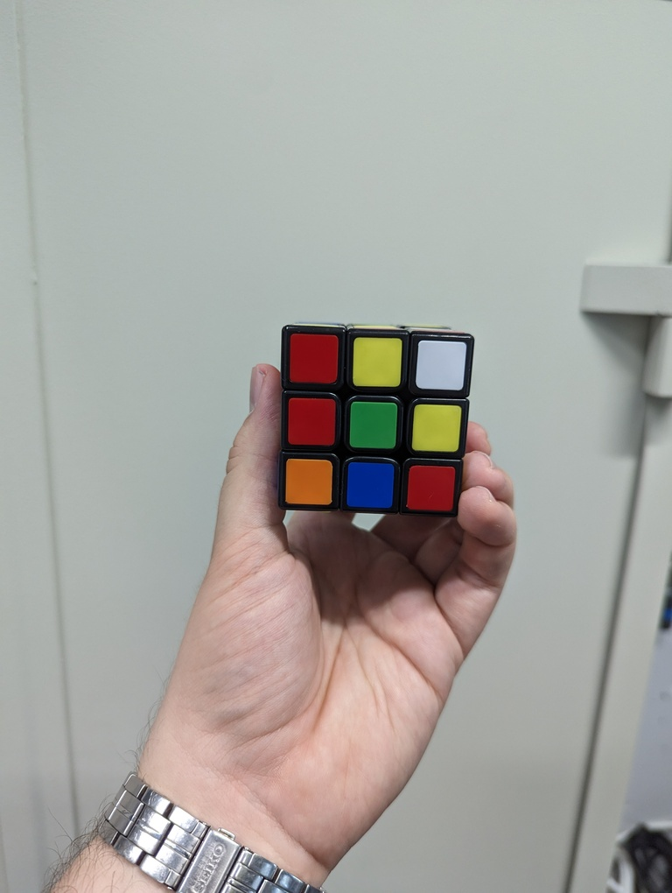
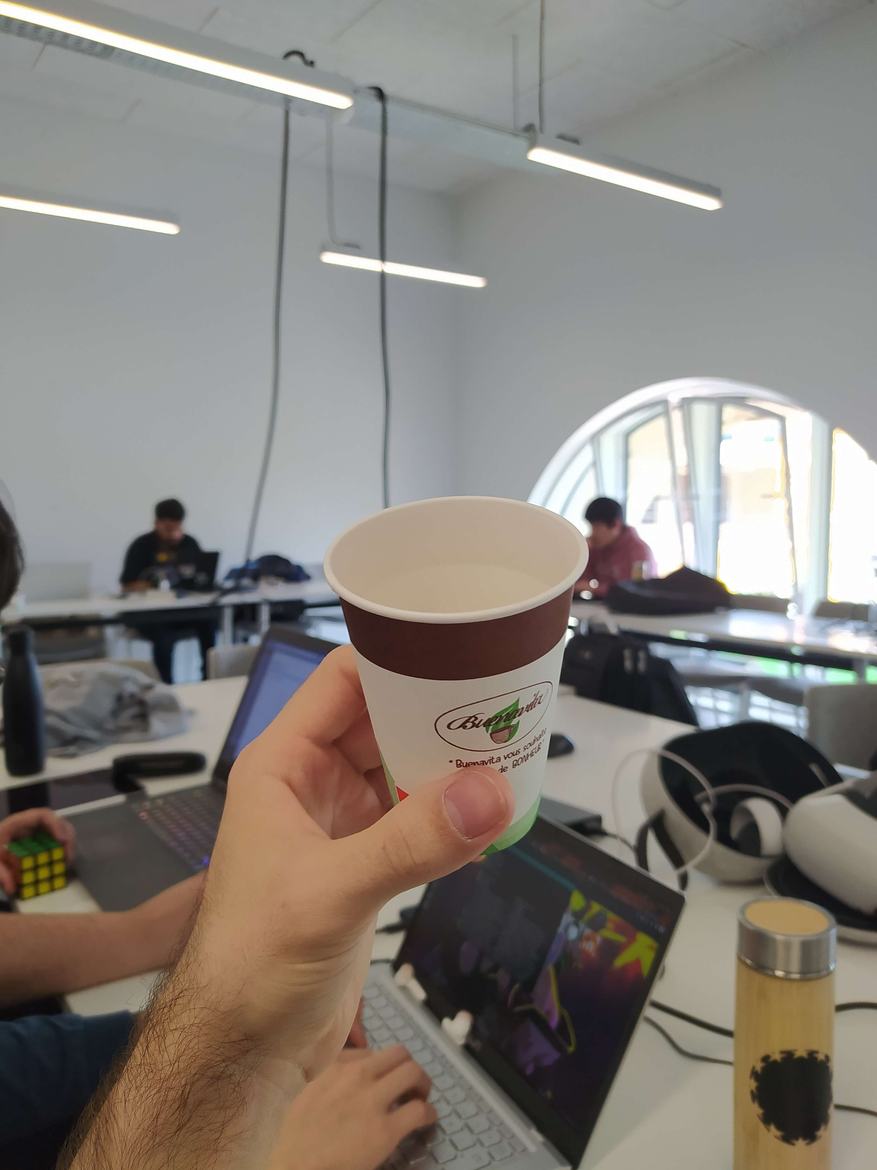
Dataset constraints
Mandatory:
Clean and high contrast background*.
Object always within frame.
Optional but helpful:
Supported object (i.e., hands don’t appear).
Avoid blurry images, defocus.
Depth of field helps with background removal.
* Recent tests show that this might not be mandatory.

Slide 9

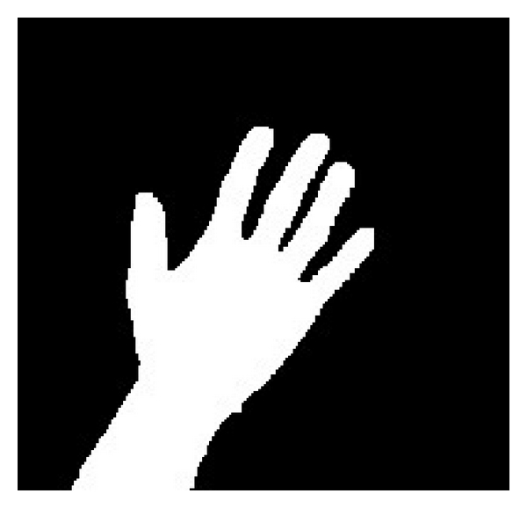
Preprocessing
RGB Video
Object-only images
Preprocessing
Background Removal
Hand segmentation
+
OR
👀 Segment Everything Everywhere All At Once (SEEM)

Slide 10
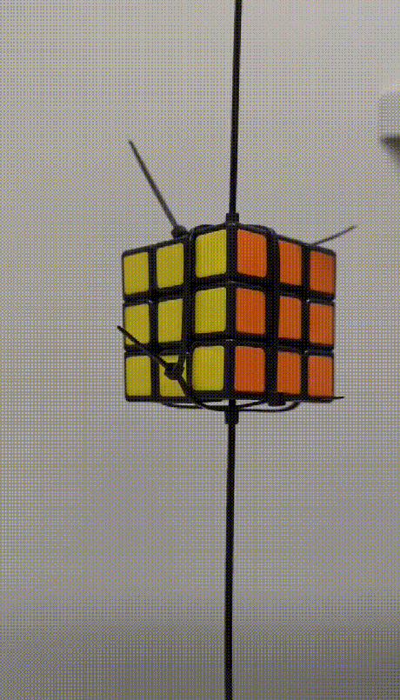
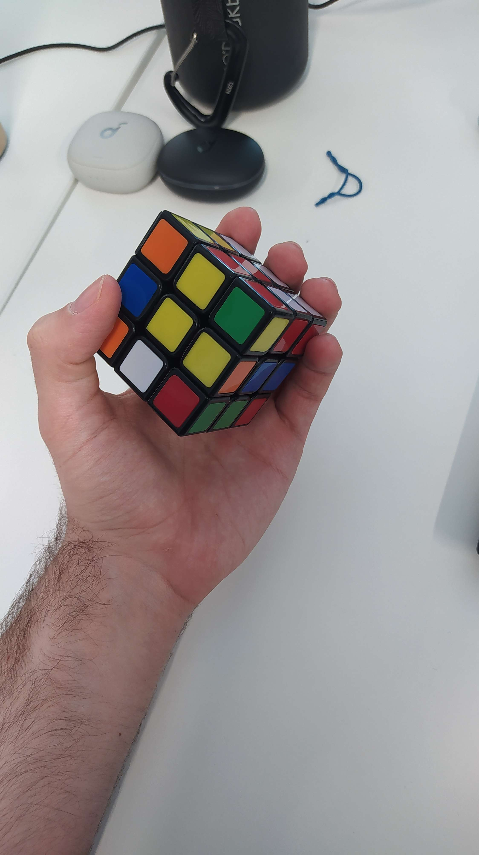
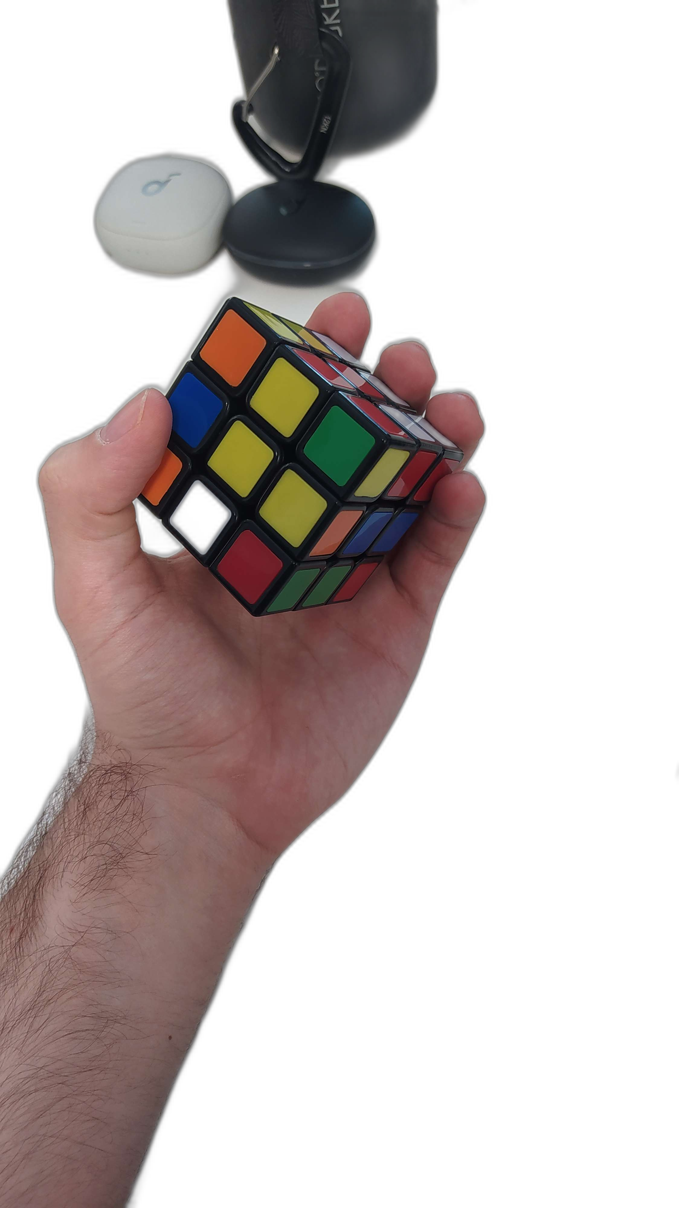
Background Removal
Rembg
U2-Net based method to segment distinct region of the image
Very efficient with extracting object from the image
Problem
Rembg is efficient when the model is by itself, but it works very poorly with hand-held objects

Slide 11
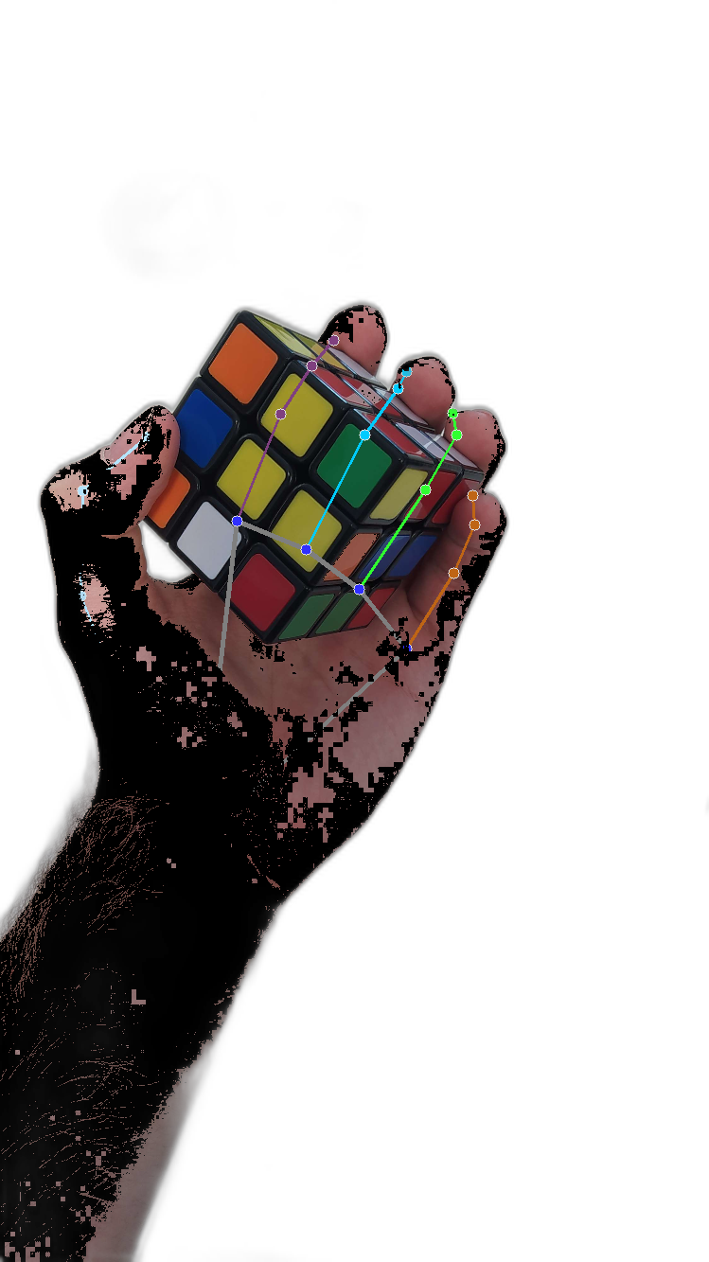
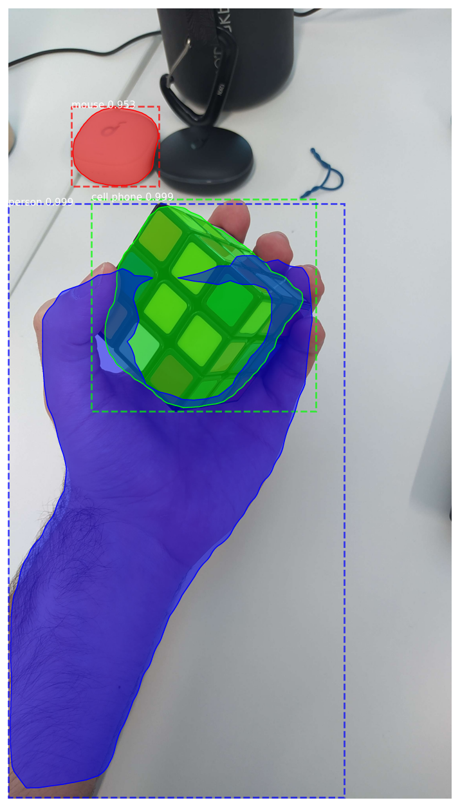
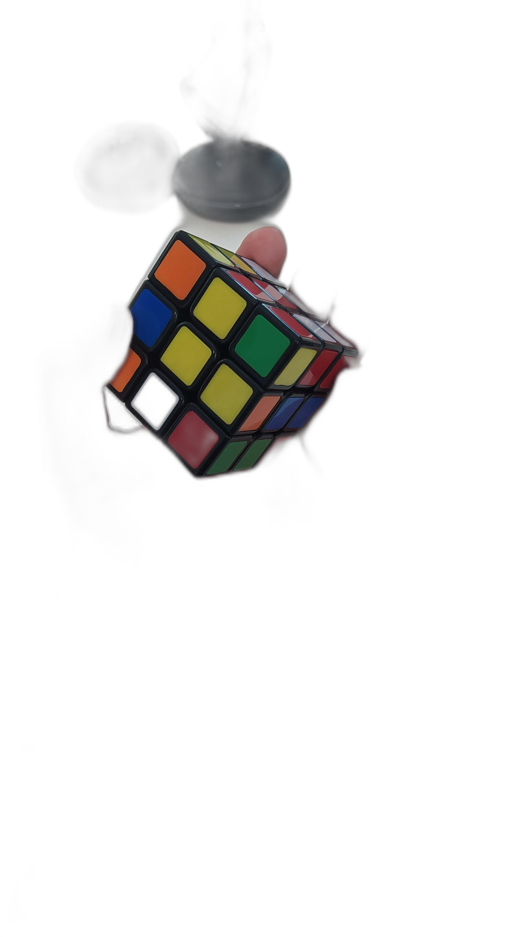
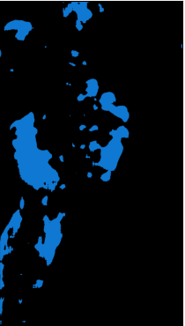
Hand Segmentation
Original
Rembg
HSV segment
Mask rcnn
Rembg x2
DeepLabv3

Slide 12
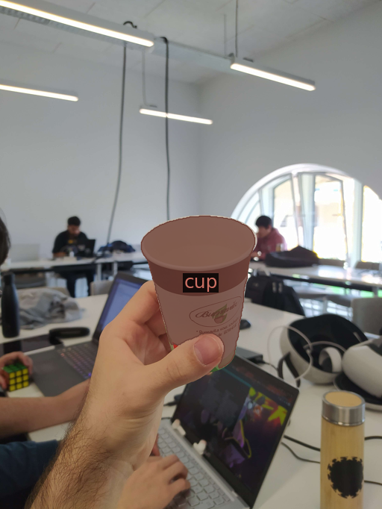
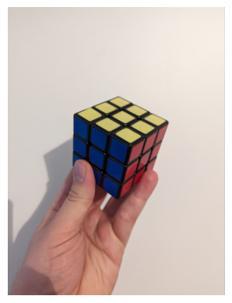
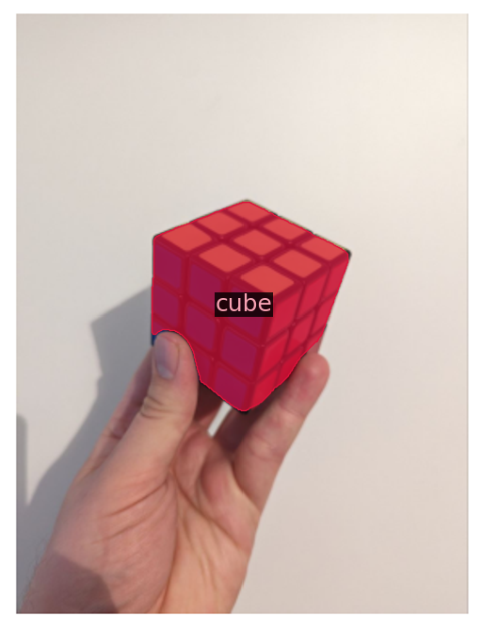
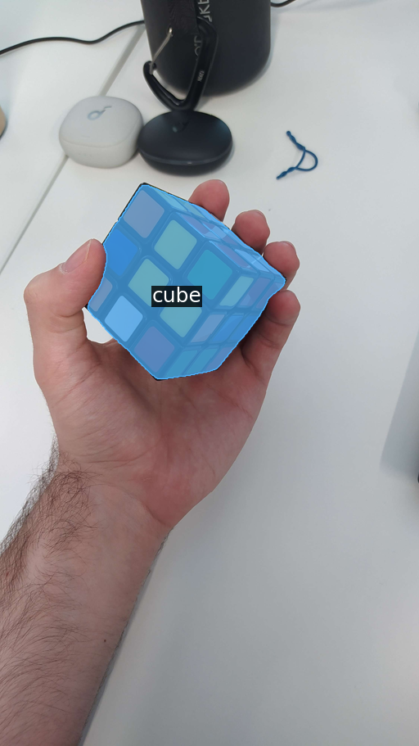
Alternative: SEEM for object segmentation
Recent segmentation architecture
Supports semantic, instance, panoptic segmentation
Input prompt: visual, text, reference, and composition

Slide 13
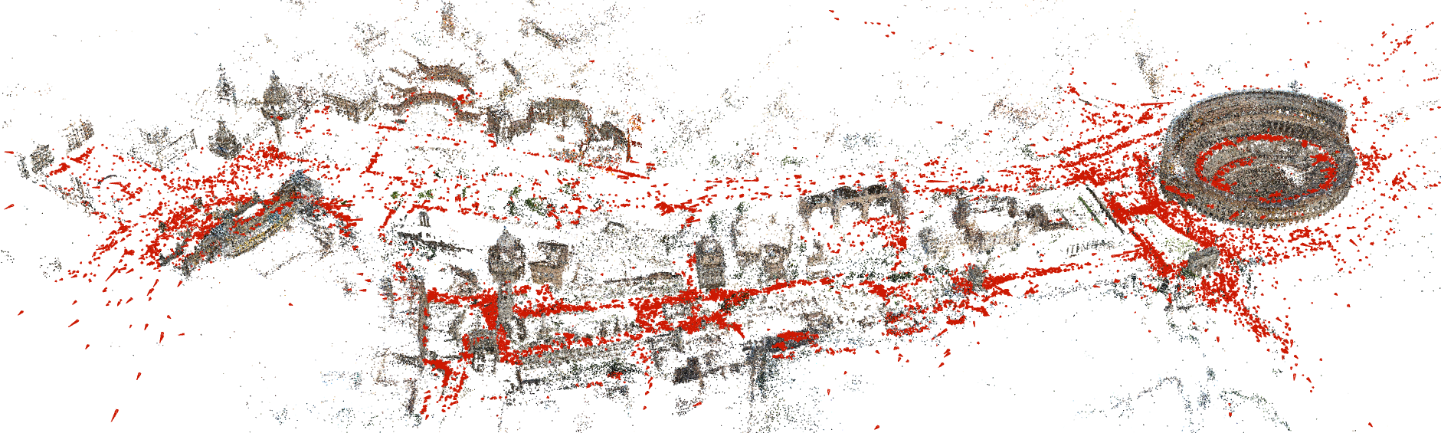
Camera pose estimation with COLMAP
Schönberger et al. 2016

Slide 14
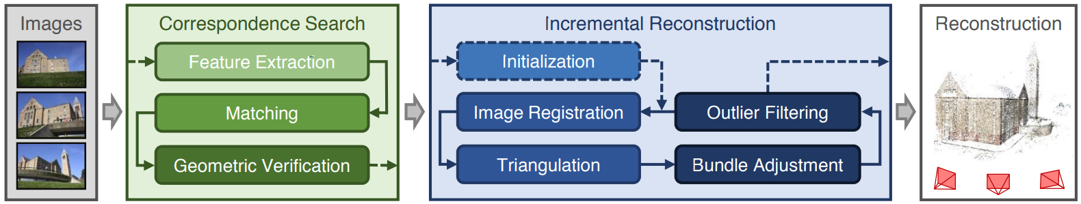
Incremental Structure-from-Motion pipeline
Schönberger et al. 2016
Correspondence Search: find scene overlap in input images and identify projections of the same points in overlapping images.
Incremental Reconstruction: find pose estimates for registered images and the reconstructed scene structure as a set of points.

Slide 15

NeRF
Mildenhall et al. (2020)

Slide 16
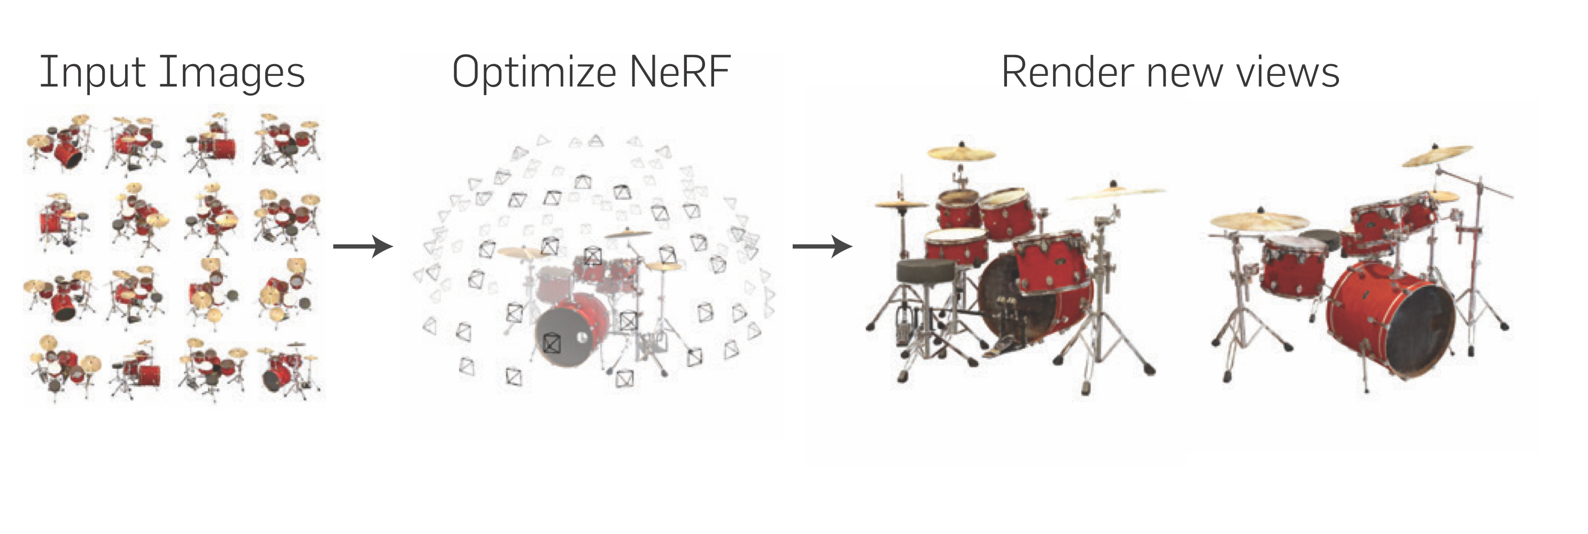
NeRF Overview
Introduced by Mildenhall et al. in 2020
Volumetric Rendering based on a neural scene representation
Mildenhall et al. (2020)

Slide 17
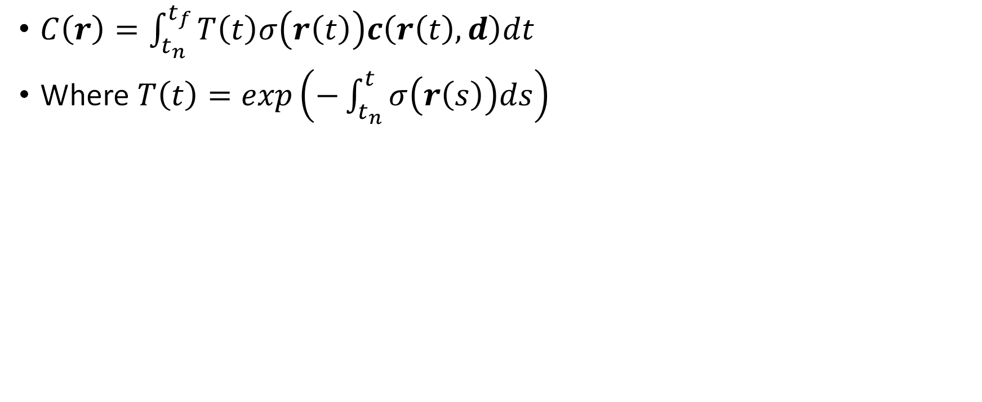
Volume Rendering
$C\left(r\right)=\int_{t_{n}}^{t_{f}}{T\left(t\right)σ\left(r\left(t\right)\right)c\left(r\left(t\right),d\right)dt}$
Where $T\left(t\right)=exp\left(−\int_{t_{n}}^{t}{σ\left(r\left(s\right)\right)ds}\right)$

Slide 18
Volume Rendering
$C\left(r\right)=\int_{t_{n}}^{t_{f}}{T\left(t\right)σ\left(r\left(t\right)\right)c\left(r\left(t\right),d\right)dt}$
Where $T\left(t\right)=exp\left(−\int_{t_{n}}^{t}{σ\left(r\left(s\right)\right)ds}\right)$
What does that mean?

Slide 19
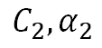
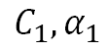
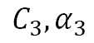
Alpha Blending
$$C_{3},α_{3}$$
$$C_{2},α_{2}$$
$$C_{1},α_{1}$$

Slide 20
Alpha Blending
$$C_{final}=α∗C_{new}+\left(1−α\right)∗C_{previous}$$
$$C_{3},α_{3}$$
$$C_{2},α_{2}$$
$$C_{1},α_{1}$$

Slide 21
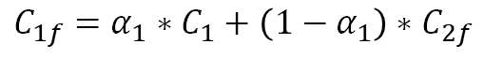
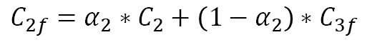
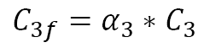
Alpha Blending
$$C_{final}=α∗C_{new}+\left(1−α\right)∗C_{previous}$$
$$C_{3f}=α_{3}∗C_{3}$$
$$C_{2f}=α_{2}∗C_{2}+\left(1−α_{2}\right)∗C_{3f}$$
$$C_{3},α_{3}$$
$$C_{1f}=α_{1}∗C_{1}+\left(1−α_{1}\right)∗C_{2f}$$
$$C_{2},α_{2}$$
$$C_{1},α_{1}$$

Slide 22
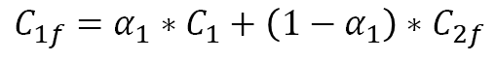
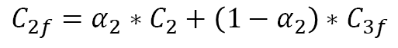
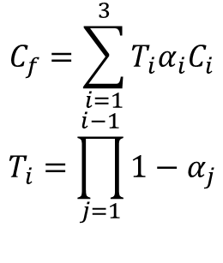
Alpha Blending
$$C_{3f}=α_{3}∗C_{3}$$
$$C_{2f}=α_{2}∗C_{2}+\left(1−α_{2}\right)∗C_{3f}$$
$$C_{1f}=α_{1}∗C_{1}+\left(1−α_{1}\right)∗C_{2f}$$
$$C_{f}=α_{1}C_{1}+\left(1−α_{1}\right)∗α_{2}C_{2}+\left(1−α_{1}\right)\left(1−α_{2}\right)∗α_{3}C_{3}$$
$$C_{3},α_{3}$$
$$C_{f}=\sum_{i=1}^{3}{{T_{i}α}_{i}C_{i}}$$
$$T_{i}=\prod_{j=1}^{i−1}{1−α_{j}}$$
$$C_{2},α_{2}$$
$$C_{1},α_{1}$$

Slide 23
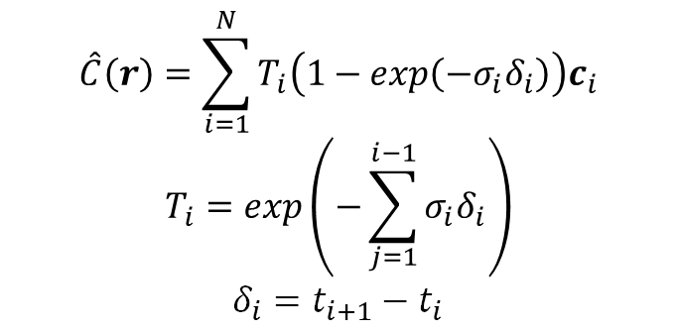
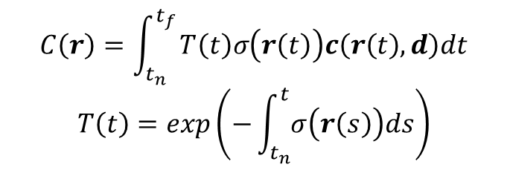
Volume Rendering
$$\hat{C}\left(r\right)=\sum_{i=1}^{N}{T_{i}\left(1−exp\left(−σ_{i}δ_{i}\right)\right)c_{i}}$$
$$T_{i}=exp\left(−\sum_{j=1}^{i−1}{σ_{i}δ_{i}}\right)$$
$$δ_{i}=t_{i+1}−t_{i}$$
$$C\left(r\right)=\int_{t_{n}}^{t_{f}}{T\left(t\right)σ\left(r\left(t\right)\right)c\left(r\left(t\right),d\right)dt}$$
$$T\left(t\right)=exp\left(−\int_{t_{n}}^{t}{σ\left(r\left(s\right)\right)ds}\right)$$
Sampling

Slide 24
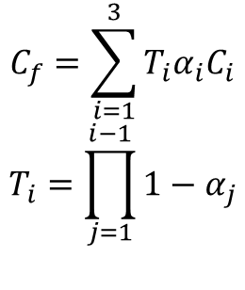
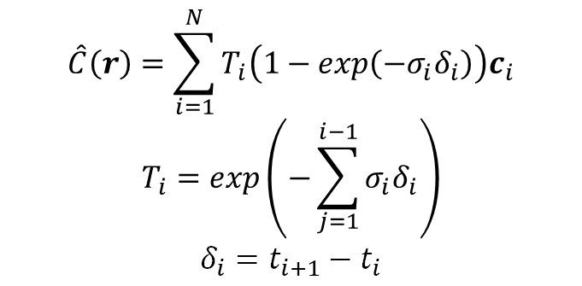
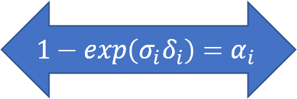
Volume Rendering
$$\hat{C}\left(r\right)=\sum_{i=1}^{N}{T_{i}\left(1−exp\left(−σ_{i}δ_{i}\right)\right)c_{i}}$$
$$T_{i}=exp\left(−\sum_{j=1}^{i−1}{σ_{i}δ_{i}}\right)$$
$$δ_{i}=t_{i+1}−t_{i}$$
$$C_{f}=\sum_{i=1}^{3}{{T_{i}α}_{i}C_{i}}$$
$$T_{i}=\prod_{j=1}^{i−1}{1−α_{j}}$$
$$1−exp\left(σ_{i}δ_{i}\right)=α_{i}$$

Slide 25
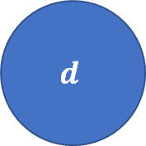
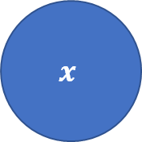


Neural Representation
MLP
8x256
$$σ$$
$$x$$
Features
256
FC
128
$$c$$
$$d$$

Slide 26
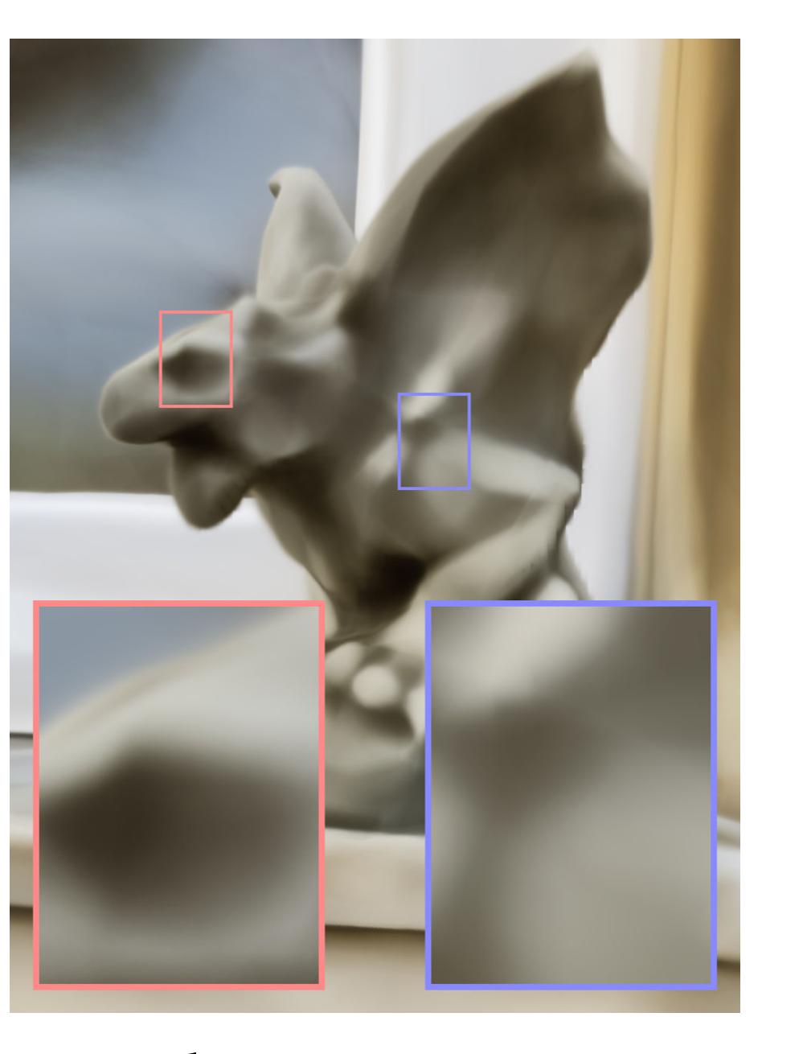
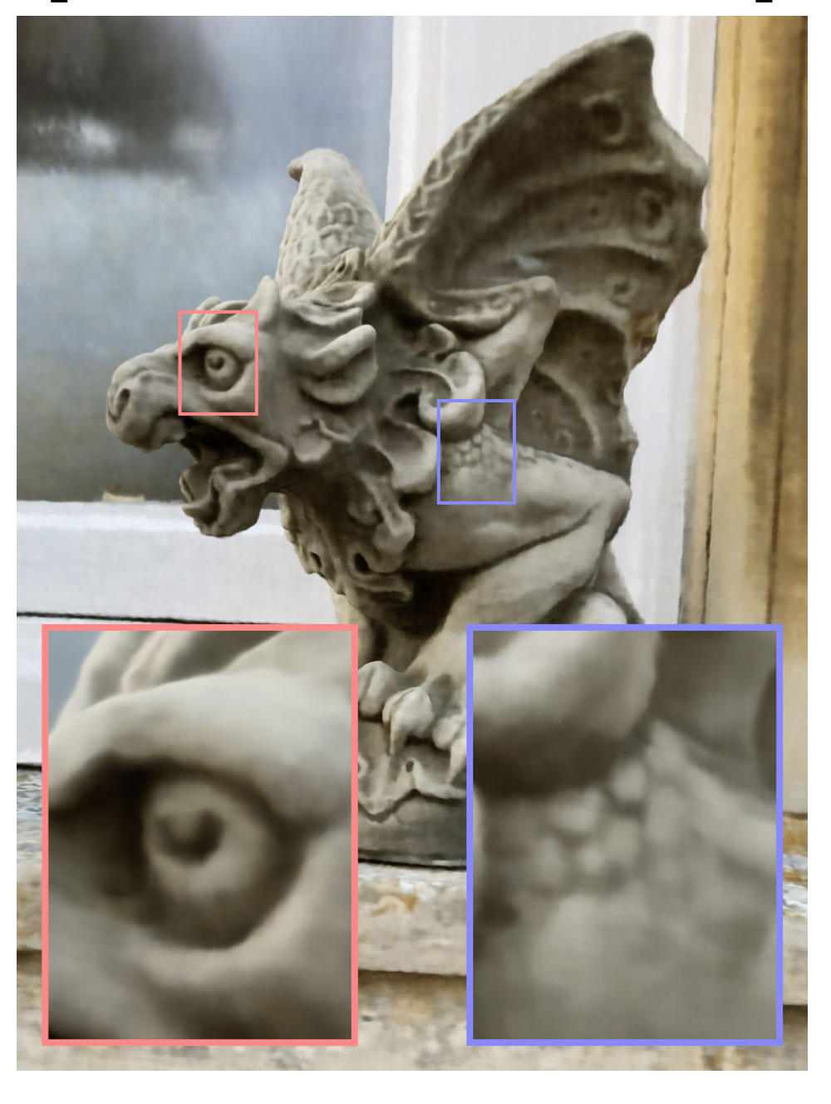
Positional Encoding
Müller et al. (2022)
Müller et al. (2022)

Slide 27
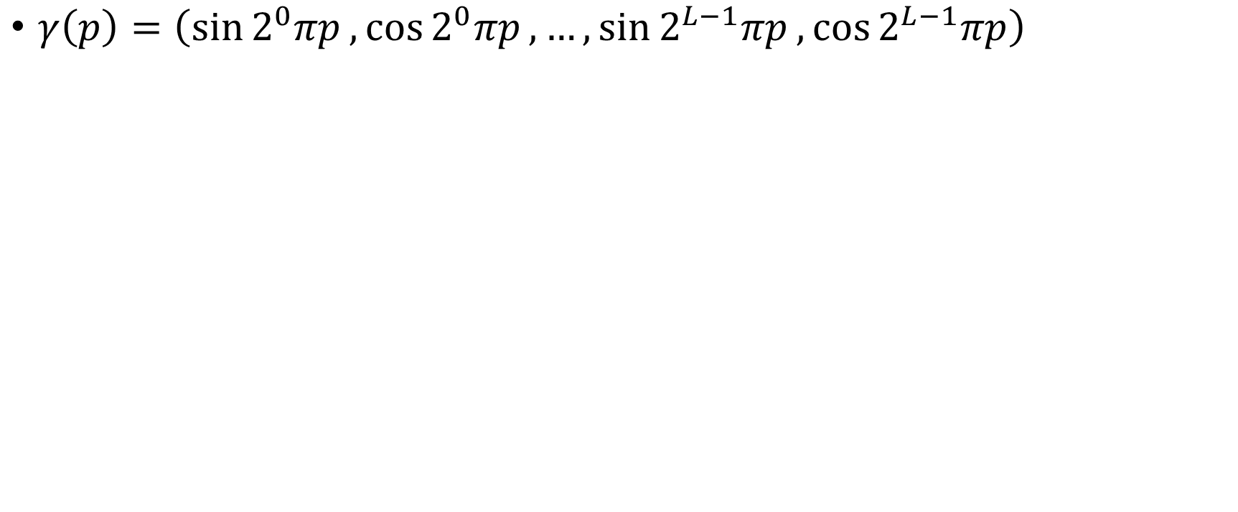
Positional Encoding
$γ\left(p\right)=\left(\sin{2^{0}πp},\cos{2^{0}πp},…,\sin{2^{L−1}πp},\cos{2^{L−1}πp}\right)$
Notes:
Original paper: L=10 for position, L=4 for direction

Slide 28
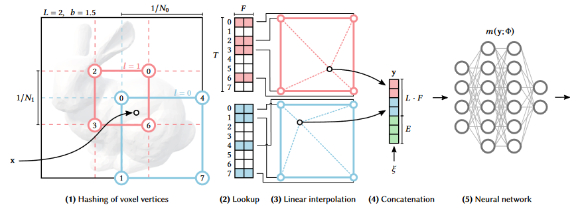
Instant NGP
Müller et al. (2022)

Slide 29
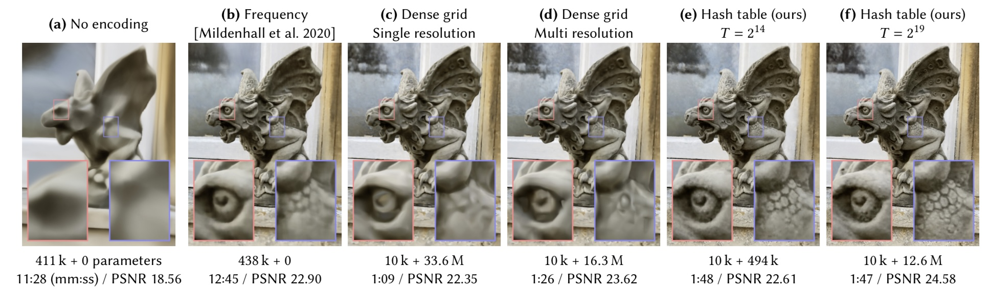
Instant NGP
Müller et al. (2022)

Slide 30
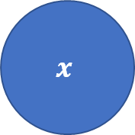

Instant NGP
$$σ$$
MLP
1x64
Features
16
Hashtable
Encoding
$$x$$
MLP
2x64
$$c$$
$$d$$
Notes:
Direction encoded in spherical harmonics

Slide 31

Meshing
Wikipedia

Slide 32
Progress so far: supported
RGB Video
3D Representation (NeRF)
Generated mesh (Marching Cubes)
Restrictions: supported object with clean background
Problem: zip-ties appear in the 3D representation

Slide 33

Progress so far: handheld
Restrictions: clean background
Problem: background removal + hand segmentation leave too many artifacts. SEEM is potentially the best.

Slide 34
Thanks for listening!

Slide 35
References
Mildenhall, Ben, et al. "Nerf: Representing scenes as neural radiance fields for view synthesis." ECCV 2020, Proceedings, Part I (2020): 405-421
Müller, Thomas, et al. "Instant neural graphics primitives with a multiresolution hash encoding." ACM Transactions on Graphics (ToG) 41.4 (2022): 1-15.
Zou, Xueyan, et al. "Segment everything everywhere all at once." arXiv preprint arXiv:2304.06718 (2023).
Schonberger, Johannes L., and Jan-Michael Frahm. "Structure-from-motion revisited." Proceedings of the IEEE conference on computer vision and pattern recognition. 2016.

